Slide 1
Introduction to R
Ioannis Siavelis
2024 / 11 /18

Slide 2
What is R?
R is a programming language designed for:
Data analysis
Statistics
Visualization
Used by:
Data scientists, statisticians, researchers.

Slide 3
R is:
free software
R has a strong focus on interactive analysis
A general-purpose programming, interpreted language (like Python, and unlike C or C++). Existing methods can be combined into complex analysis workflows through R script files.

Slide 4
Over 10,000 packages (methods in statistics, data processing, bioinformatics, machine learning and many other disciplines) available in R!

Slide 5
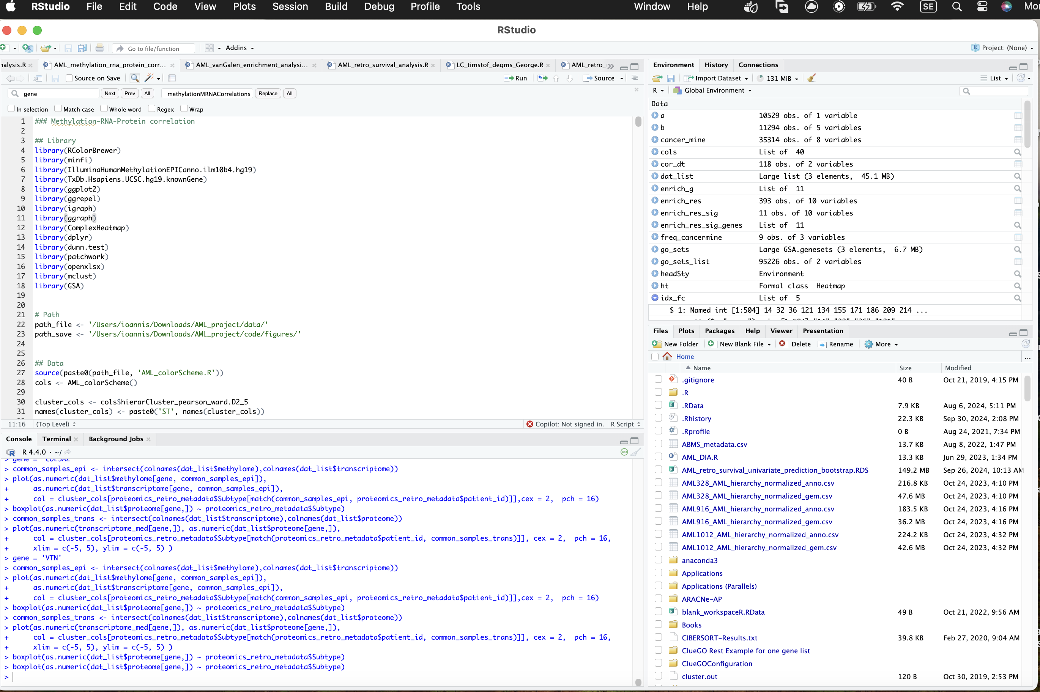
an integrated development environment (IDE) built on top of R
Source
(code editor)
Environment
Working
Directory/
Output
Console

Slide 6
Open Rstudio
https://cran.r-project.org
https://posit.co/download/rstudio-desktop/

Slide 7
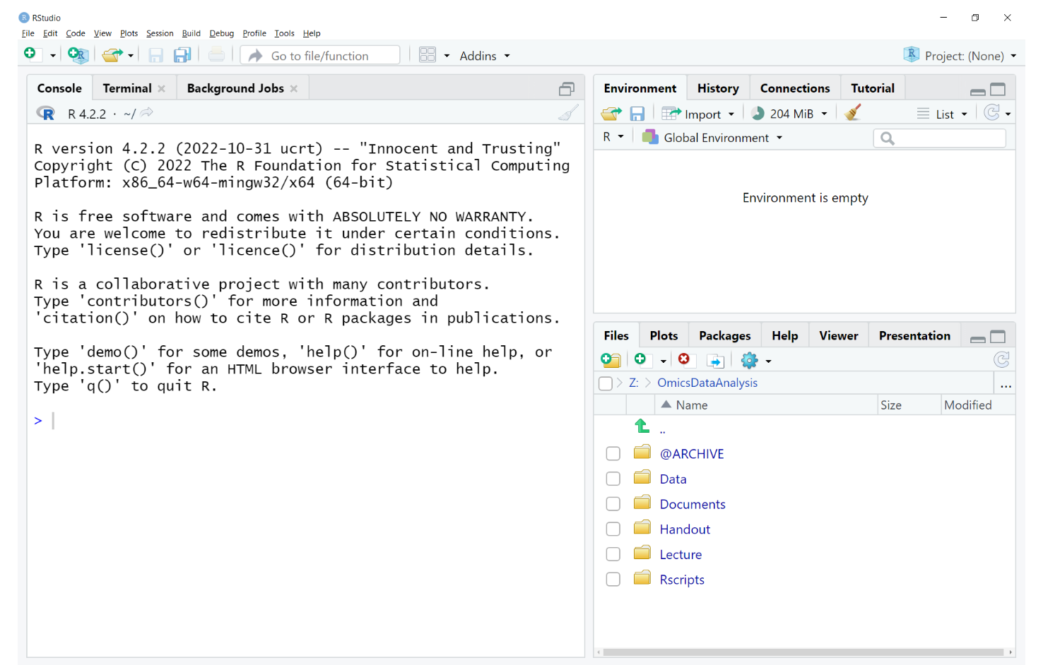
Notes:
Demonstration

Slide 8
Basic workflow
Start RStudio
In the console pane (at the command prompt >), a steady loop:
Type input, hit return
Evaluates input and displays result(text output, plot)
Based on results, provide new input
3. Quit (and save, if necessary)

Slide 9
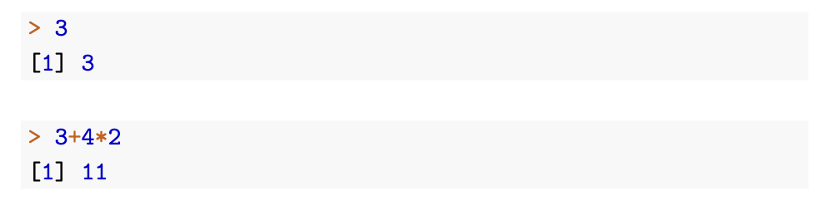
Text after the prompt > is typed by you, text below, usually starting with [1], is output generated by R.
Numeric
Note:you can browse through previous input via the arrow keys, edit and re-use it.

Slide 10
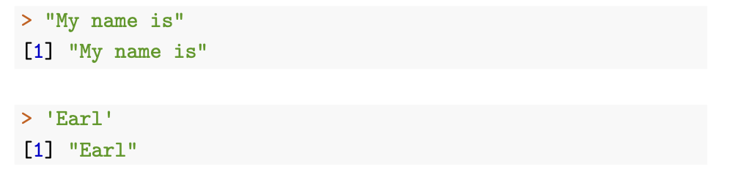
R also uses character expressions (strings)
Character values are enclosed in single ' or double " quotation marks:

Slide 11
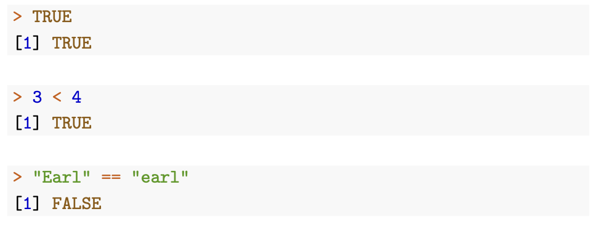
R also uses logical (or boolean) expressions, e.g. to select subsets of data or to test for conditions. These expressions have only two possible values, TRUE and FALSE

Slide 12
Functions
Pre-packaged pieces of code that can perform a specific task.
Functions have names, and zero, one or more arguments, i.e. slots for pieces of information that the function either operates upon (data), or that tell the function what to do (flags, parameters).
To run a function, you type its name at the console, followed by a pair of parentheses with the arguments for what you want the function to do, separated by commas.

Slide 13
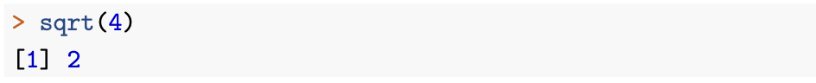
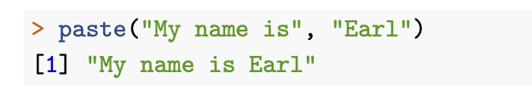
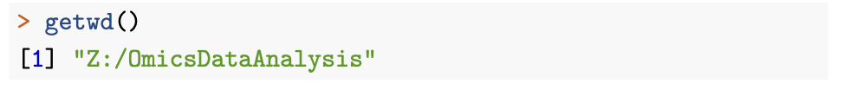
Examples of functions
we still need to add an (empty) pair of parentheses to indicate that you want the function to run, even though no argument is given.
R uses slashes (/), not backslashes (\), for separating file- and folder names in a path.

Slide 14
In some situations, however, you want a function to simply do something, e.g. create a plot or write data to a file
Most functions are available at the command prompt after starting R/RStudio.
Other functions require specialized add-on packages, which need to be loaded before you can use their functions
R and its add-on packages have large amounts of documentation available. In the simplest case, when you remember the name of the function, you can just type

Slide 15
TAB
When typing the function name in RStudio, hitting the tabulator-key will open a context menu at the cursor that lists all available function names that complete the already typed text
Once you have typed or selected the function name with the trailing parentheses, you can move the cursor between these parentheses and hit the tabulator- key again to get a scrollable, reactive list of the function arguments (with documentation).

Slide 16
Objects
To avoid re-calculating the same expression repeatedly, we store results as objects under a freely chosen name
R saves a copy of the specified result in its memory, and from there on, you can use the name to refer to the result.

Slide 17
Objects
To assign a value to a chosen name in R, you can use the operator <-
(you can also use a single equal sign =)
Limitations for object names: they can only contain letters, numbers, dots . and underscores _, and they cannot start with a number.

Slide 18
Object naming
Snake case vs Camel case
variable_id - variableId
user_name - userName
plot_expr - plotExpr
plot_expr_scatter - plotExprScatter

Slide 19
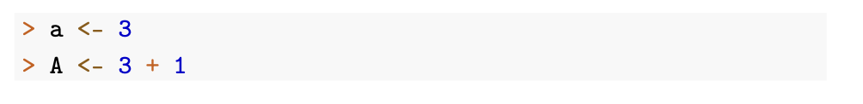
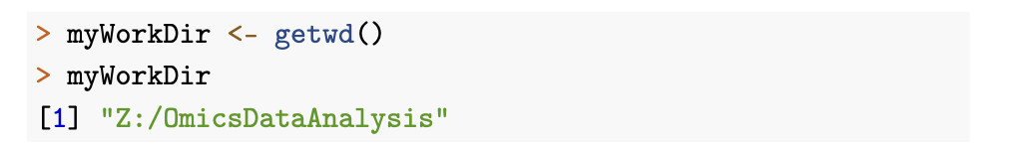
Examples of objects
Objects are around until further notice or until the user quits R. So you get the same value for object a as before.

Slide 20
Environment
In order to get an overview of what objects are currently defined, you can either check the Environment tab in RStu- dio, which shows a list of the currently defined objects, or run a command at the prompt:

Slide 21
Once an object is defined, it will stay defined and available for the rest of the R session. However, you can change the content of the object through a new assignment to the same name.

Slide 22
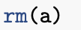
To remove an object completely, so that its name is no longer defined, you can use the function rm

Slide 23
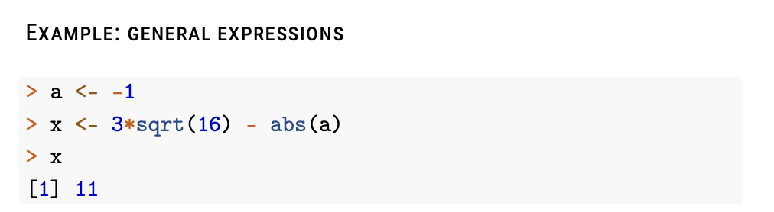
Combining all together

Slide 24
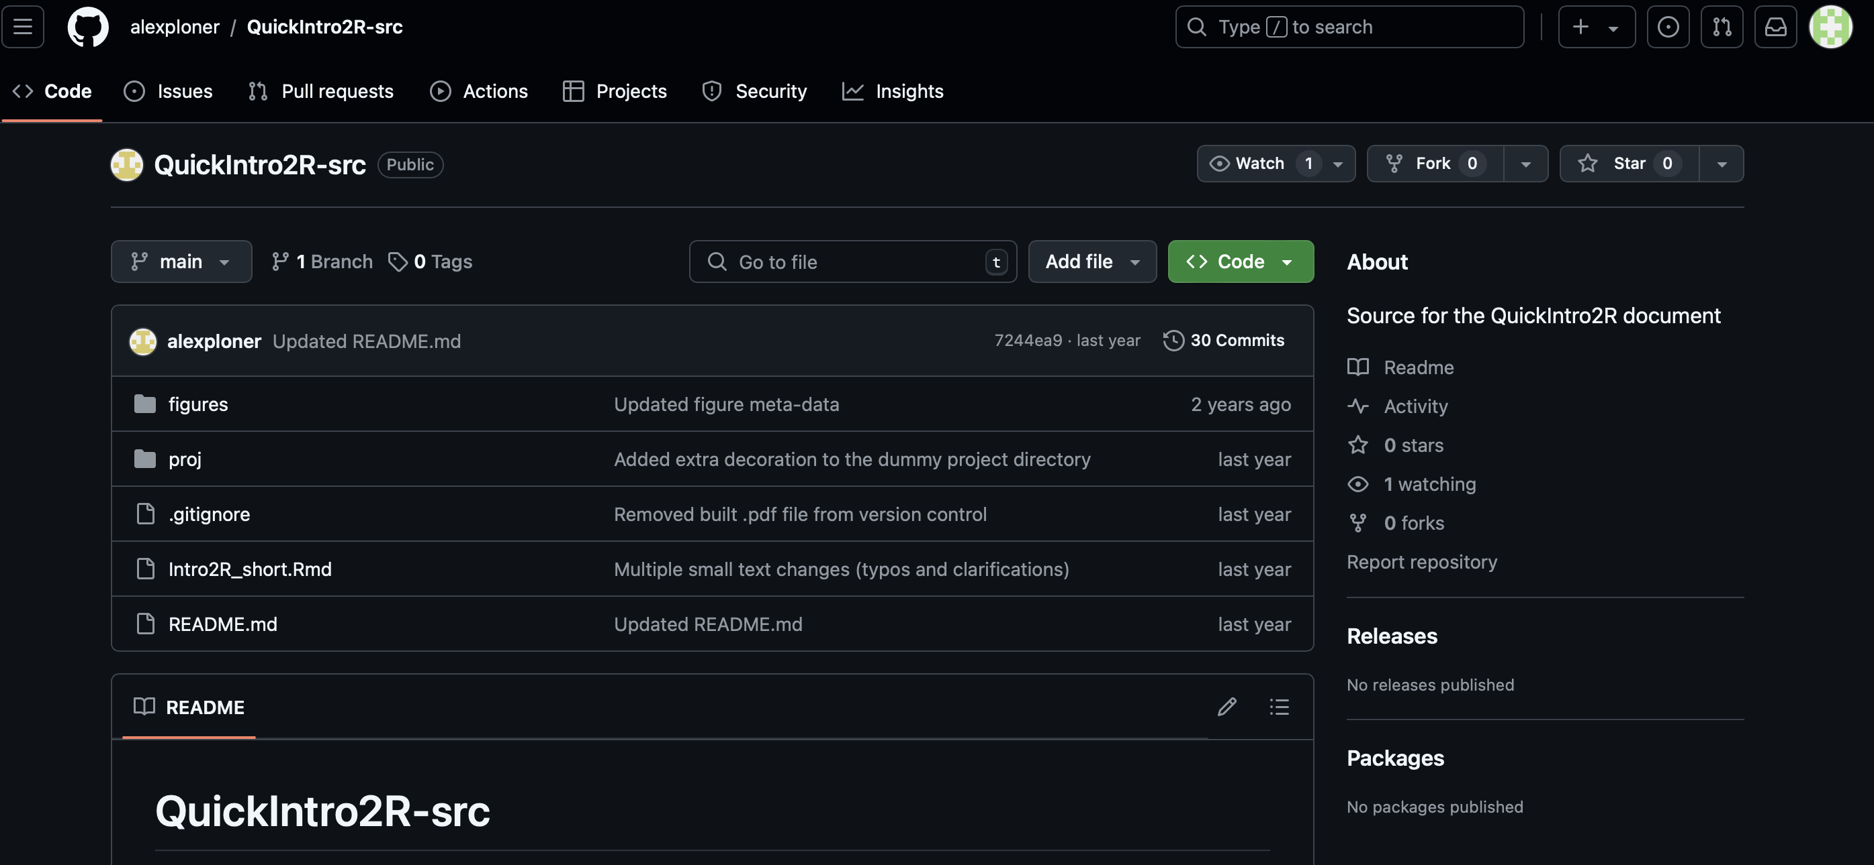
https://github.com/ioasia/QuickIntro2R-src

Slide 25
Exercises part1
2024 / 11 /18

Slide 26
Basic data types (n = 1)
Numerical
Character
Logical
(Factor) - converted manually to a factor using the function of the same name

Slide 27
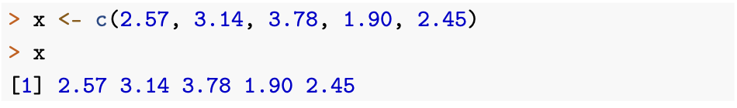
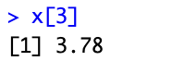
Basic data structures (n > 1)
how multiple items of information can be arranged and used together
The simplest data structure for multiple observations is linear and corresponds to measurements of a single variable.

Slide 28
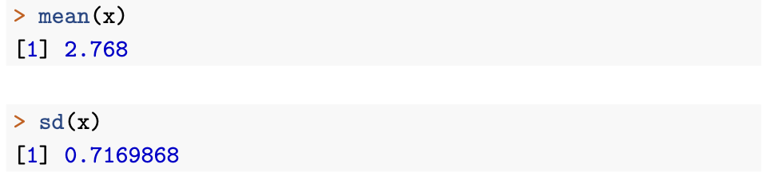
Functions on vectors
You can also the vector as argument to functions, e.g. for calculating basic descriptive statistics

Slide 29
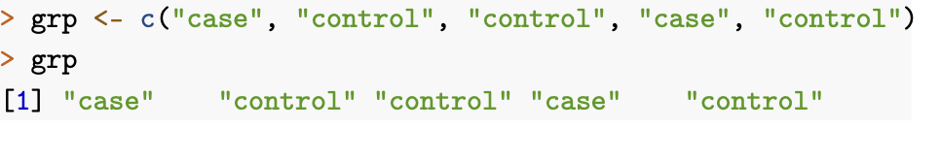
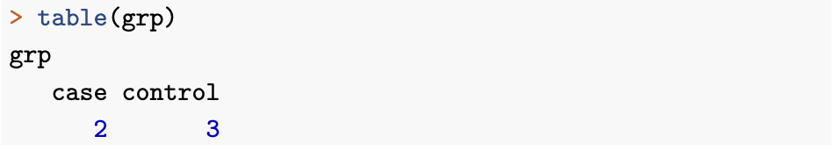
Character vectors
In the same way, you can define character vectors for keeping track of non-numeric observations for a set of subjects, e.g. identifiers or group labels. A possible grouping variable for the same five subjects as above could be

Slide 30
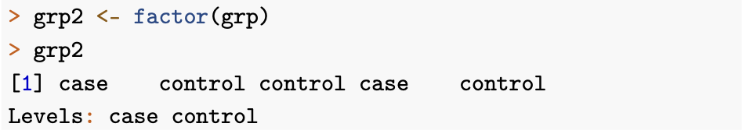
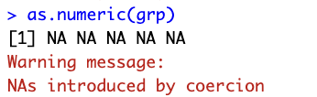
Factors
no quotation marks around the vector entries, and the levels of the factor (the different values allowed) are displayed explicitly below the data.

Slide 31
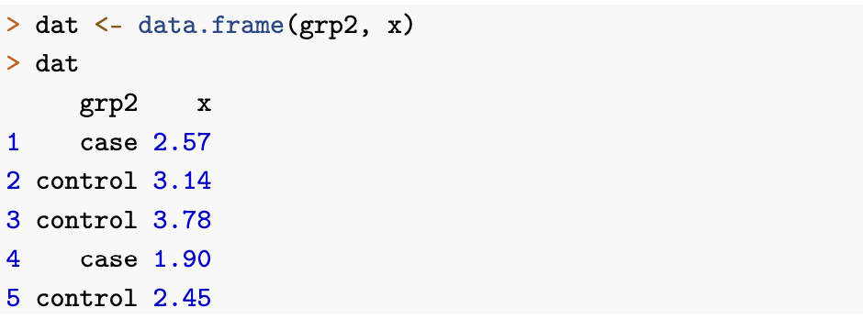
Rectangular structure: data frame
Data frame is a rectangular arrangement of information, to bring together two (or more) pieces of information.
The data is displayed arranged as rows and columns, with the names of the vectors used as column names and a running number as row name

Slide 32
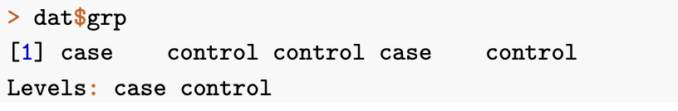
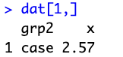
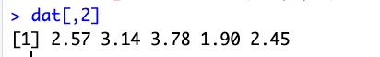
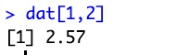
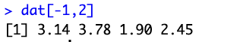
Data frame manipulation
A simple way of extracting a variable is the $-notation:
Or using []:

Slide 33
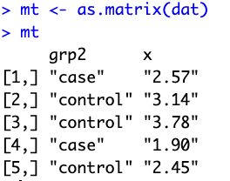
Rectangular structure: matrix (all values are of the same data type)
Coercion
Logical → Integer → Numeric → Character

Slide 34
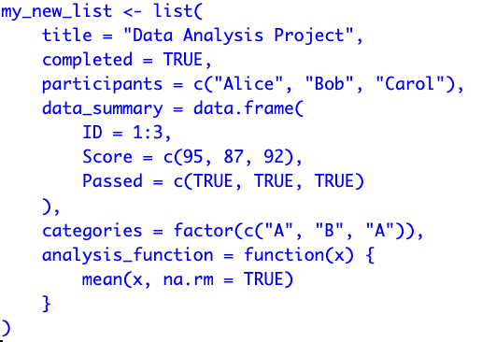
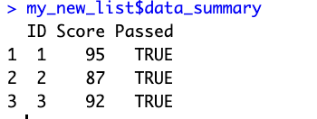
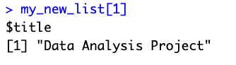
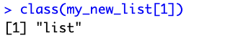
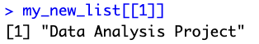
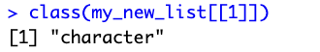
Lists
a list is a flexible data structure that can hold elements of different types, including vectors, matrices, data frames, or even other lists.

Slide 35
Exercises part2
2024 / 11 /18

Slide 36
Reading and manipulating files
Set the working directory & load the data
Run some descriptive statistics
Run the main analysis of interest, here some statistical inference (estimates, confidence intervals, p-values).
Export results
Shutdown R/RStudio: this requires a decision whether to save the R objects generated during the workflow.

Slide 37
Basic data format
Variables
Samples
 | Sample1 | Sample2 | Sample3 | Sample4 | … | Sample100
Gene1 | 0.23 | 0.12 | 2.02
Gene2 | 0.5
Gene3
…
Gene10000

Slide 38
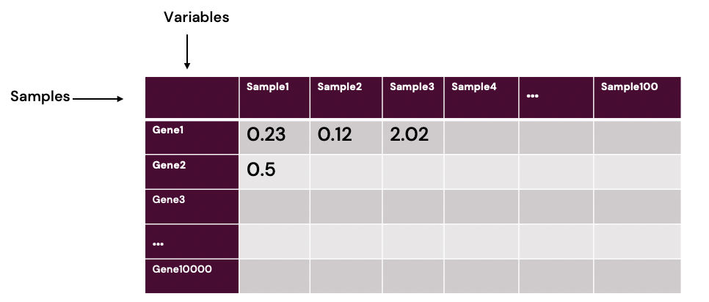
Wide vs Long format
Wide
Long
SampleName | Variables | Value
Sample 1 | Gene 1 | 0.23
Sample 1 | Gene 2 | 0.5
Sample 1 | Gene 3
Sample 1 | Gene 4
Sample 1 | Gene 5
… | …
Sample 2 | Gene 1 | 0.12
Sample 2 | Gene 2

Slide 39
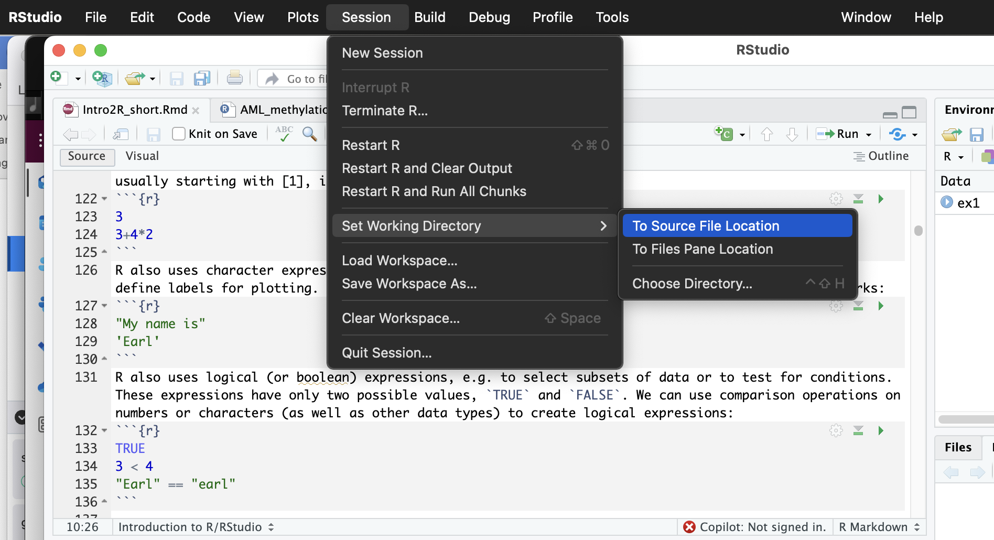
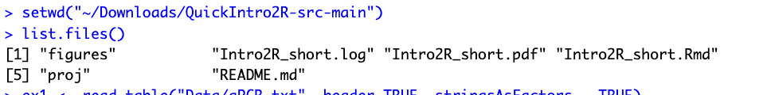
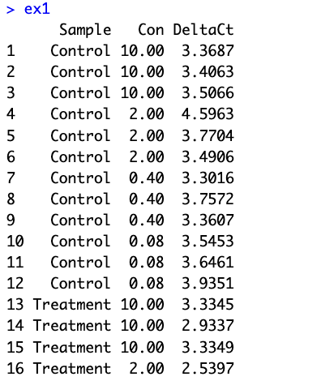
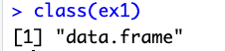
Working directory
Session -> Set Working Directory ->To Source File Location

Slide 40
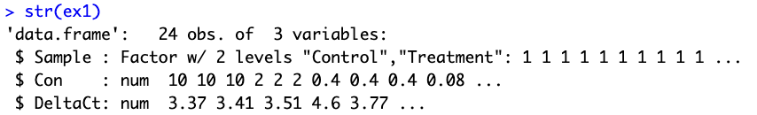
Structure function

Slide 41
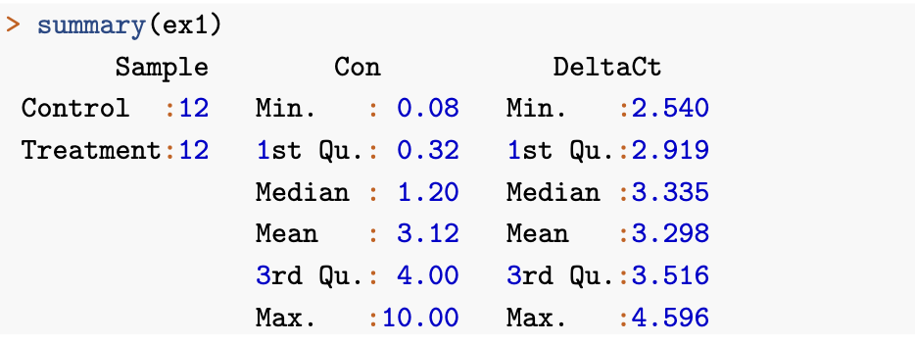
Summary function

Slide 42
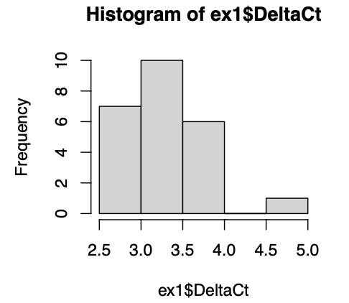
Plots (base graphics, other powerful approach is ggplot2)

Slide 43
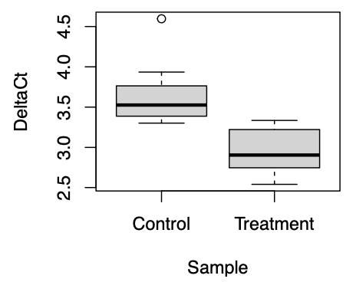
Plots
The first argument in this function call is a formula, an R construction that is widely used for specifying e.g. plots and regression models; the ~ character is best read “as a function of”, so here “plot DeltaCt as a function of Sample” (where both variables are taken from the data frame ex1, as specified by the second argument).

Slide 44
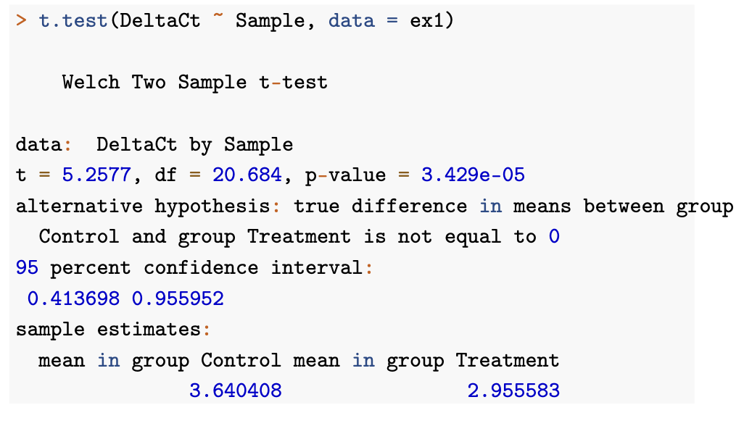
Statistical test

Slide 45
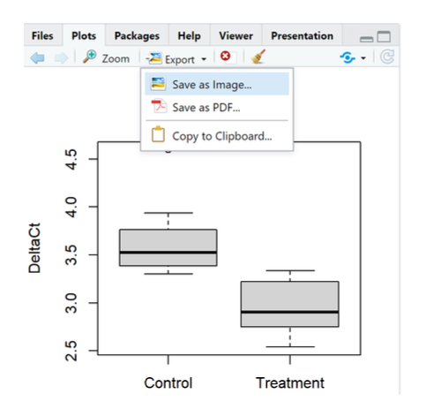
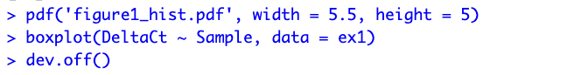
Export results
Manual export / copying and pasting is reasonably fast and convenient for a few numbers and plots, but generally not recommended, because it breaks the connection between the R code used to generate the results and the results themselves.
Instead

Slide 46
Shut down R
Select the Quit Session in the File-menu, kill the program window, or use the command q() in the console.
All data, results, and plots generated during an R/RStudio session will be lost when quitting R, unless you take steps to save them for later.
By default, R will always offer to save the workspace image when you quit a session
This means that all currently defined objects will be saved to a file called .RData in the current working directory. This file can later be loaded via the Load workspace-entry in the Session-menu, or via the load() command in the console

Slide 47
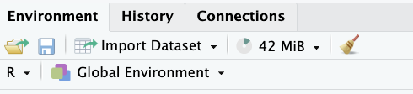
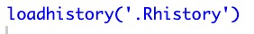
Save
You can save the current workspace image at any time via the Environment-tab or the save.image()-command.
RStudio will also save all the R commands used in the current R session (as seen in the History-pane) to a file .Rhistory in the current working directory. This is a simple text file that can be opened in any text editor or re-loaded into R via the History-pane or the loadhistory()- command.

Slide 48


R packages
packages are written using R commands, similar to the functions discussed, but may also include code from other programming languages like e.g. C++
The most important and default repository is CRAN, the Comprehensive R Archive Network, with currently more than 18,000 packages covering an extremely wide range of applications.
Bioconductor is another large(currently more than 2,000 packages) collection, focused on high-throughput molecular data.
Well-curated repositories as opposed to other sources which also host many R packages for download, like github which have variable package quality.

Slide 49
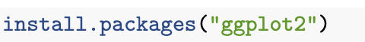
Install packages
The package needs to be installed: this means that there has to be a local copy of the data and software on a file path known to R.
Install from CRAN
Install from Bioconductor
if (!require("BiocManager", quietly = TRUE)) install.packages("BiocManager") BiocManager::install(version = "3.20")
BiocManager::install("AnnotationDbi")

Slide 50
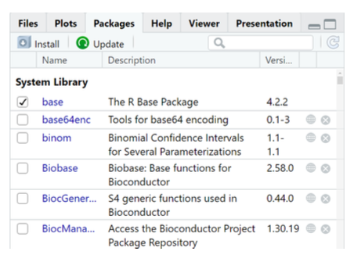
Note that installation is only required once: after the package has been installed, the local copy remains on the local hard disk for all future R sessions. But:
The package needs to be loaded: this means that R activates the installed copy of the package and makes its built-in commands and data sets available at the console. This is done via the command library by calling:
library(ggplot2)

Slide 51
Popular packages
ggplot2, a complete and modern plotting system.
dplyr,offering consistent data manipulation (SQL-style)
data.table implements a high-performance alternative to data frames for large data sets.
factoextra: data reductionmethods (e.g.principal components) and visualizations.
Limma for fitting linear models for many features in parallel.
biomaRt interfaces to online repositories for feature annotation.
Curated lists of packages that can be used for specific application areas
cran.r-project.org/web/views/
https://www.bioconductor.org/packages/release/BiocViews.html#___Workflow

Slide 52
Scripts
Why scripts? Replicability.
A script can be:
documented, making it easy to understand how and why an analysis was performed, and how to interpret the results
modified: If the data changes,or if the analysis needs to be expanded, the relevant parts can be edited, and the modified script can be re-run;
Used to generate draft reports that contain all results and graphs.

Slide 53
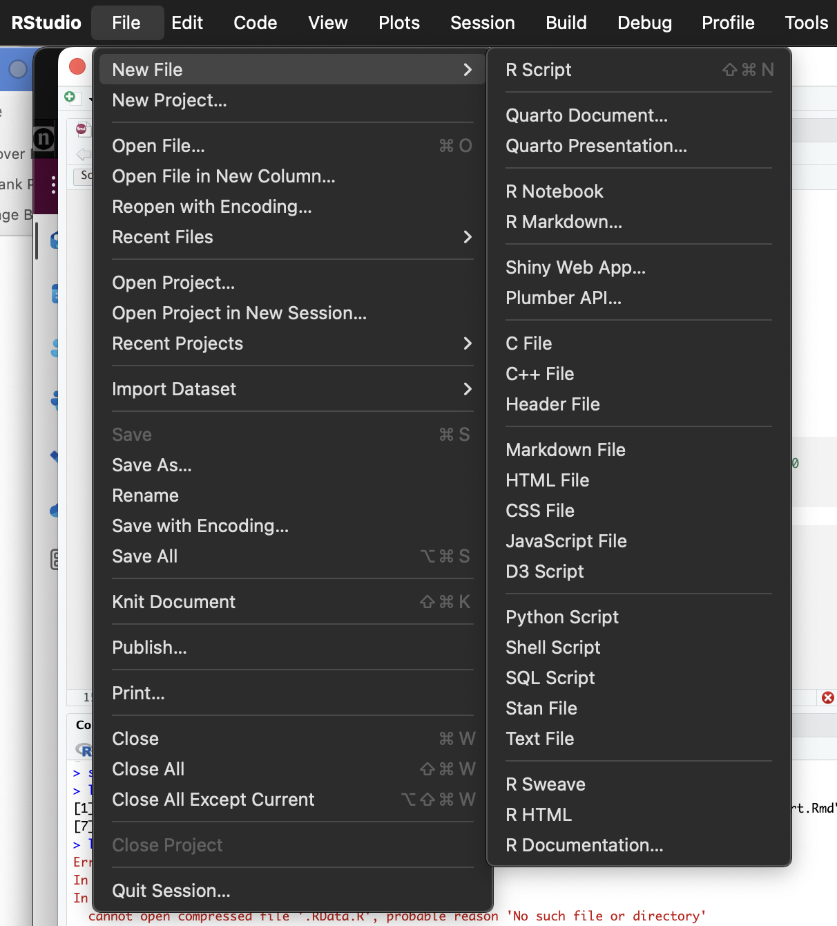
Scripts
Integrated multi-tabbed text editor with special support for editing and running R script files, supporting:
Tab expansion for R functions, function arguments and file names
Some or all of the commands can be selected and run at the console, either via the Run-Button at the top of the editor pane, or by pressing Ctrl-Return at the same time.
Once the R script with the recycled commands has been generated, it should be save directly under a suitable file name with the extension .R.

Slide 54

Scripts
Comments are text in the script that is ignored when the commands are run: this is information that helps the person reading, editing or running the script to understand what it does, and how it does it. Comments provide context and are crucial for making an analysis script easily replicable and modifiable.
# added by a hashtag

Slide 55

Running a script
A saved R script can always be opened in RStudio (as a tab in the editor pane),
The code can be selected and run via the Run-button (also Command + Enter).
The whole script (from first to last command) can be run via the Source-menu, or the source-command in the console.

Slide 56
From script to draft report
R script can be converted into a draft report by clicking the Compile at the top of the pane. This allows you choose an output format (HTML, PDF, Word), and will then
Run all commands in the script.
Collect all output generated by these commands, both graphical and numerical.
Combine all the comments, code and results in one document.
Convert that document to the chosen format.

Slide 57


R Markdown

Slide 58
Exercises part3
2024 / 11 /18

